Slide 1


COGNIZANT
CDB23CSDDW001
Resize an Image in AWS S3 Using a Lambda Function
Project Team P2

Slide 2







Group Members
Levin
Dsouza
Hitesh
Diwate
Salma Shaik
Abhay
Haridas
Chris
Francis
Shreyash Morey

Slide 3

Roles
Product Owner – Levin Dsouza
Scrum Master – Hitesh Diwate
Delivery Team -
1. Web Development Team
a. Levin Dsouza
b. Abhay Haridas
2. Backend Team
a. Shreyash Morey
b. Hitesh Diwate
3. Testing Team
a. Salma Shaik
b. Chris Francis

Slide 4

Problem Statement
Mr. Williams has a small startup by the name artist.com that offers an online marketplace for artists and designers to showcase and sell their creations. The company started growing fast, and their website was getting a lot of traffic. They had a lot of high-quality images on their platform, which slowed down the website's loading time, affecting user experience.​

Slide 5

User Stories
As a Merchant, one should be able to upload the image (png/jpeg/jpg) through a webpage for Merchant.
As a user, one should be able to see a good quality image.
The company can store only a particular size photo to reduce the cost and storage space (Image size 480 x 640 px).
As a Merchant, one should get an alert once the image is uploaded.
The company should get a resized image in their storage automatically in png/jpeg/jpg format.

Slide 6

Task
Creating a webpage for the Marchant to upload the images.
Creating the first S3 bucket(Original Size Image) for storing the uploaded images .
Creating the second S3 bucket(Resized Image) for storing the compressed images.
Writing a program to resize an image (480 X 640 px) using AWS Lambda service.
Connecting our lambda function with both the S3 buckets.
Testing our code.

Slide 7
Technology Stack
User Story | Tech-stack | Challenges | Acceptance Criteria
As a merchant, one should be able to upload the image (.png /.jpeg/.jpg) through a webpage for merchant. | HTML CSS Python(Flask, Boto3) | Using a Flask , connecting webpage to the S3 bucket. | Upload button created should be able to insert Image into S3 bucket. If there is no image uploaded and if upload button is clicked, error should be shown on web page. Upload button should work in such a way that it should accept only images in .png/.jpeg/.jpg else it should give error.

Slide 8
Technology Stack
User Story | Tech-stack | Challenges | Acceptance Criteria
As developers we need to create two s3 buckets for storing original and resized image, also create 3rd s3 bucket for backup. | Aws Storage Service(S3) | NA | Bucket should be able to store image of any dimension Bucket should be able to accept images from web page

Slide 9
Technology Stack
User Story | Tech-stack | Challenges | Acceptance Criteria
As a team we need to create lambda function for resizing the image and connecting to the s3 bucket. | Aws Storage Service(S3) | Installing the Pillow library in AWS Lambda | The lambda function should be able to accept and process any format of image The lambda function should be able to process image of any size The resized imaged should get stored in the second S3 bucket

Slide 10




Flow Diagram
Amazon Simple Storage Service (Amazon S3)
AWS Lambda
Amazon Simple Storage Service (Amazon S3)
Merchant Webpage
S3 bucket for storing original Image
Lambda Function
S3 bucket for storing Resize Image
Market place Webpage

Slide 11
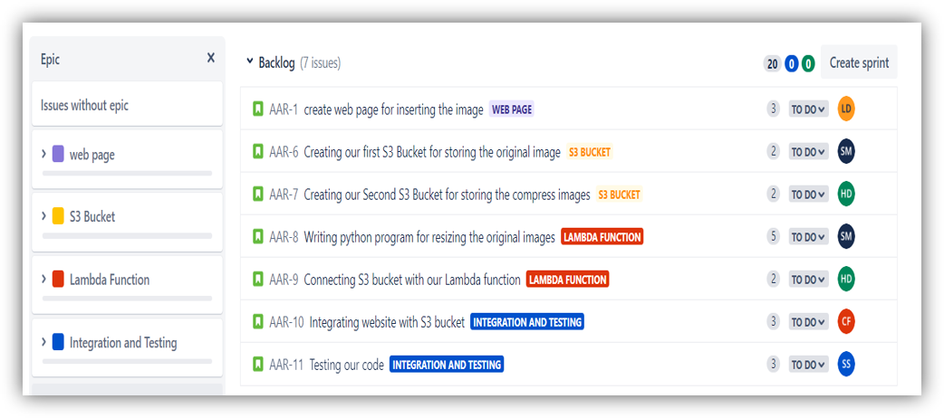
Work done in Jira
Link - https://hiteshdiwate.atlassian.net/jira/software/projects/AAR/boards/3/backlog

Slide 12
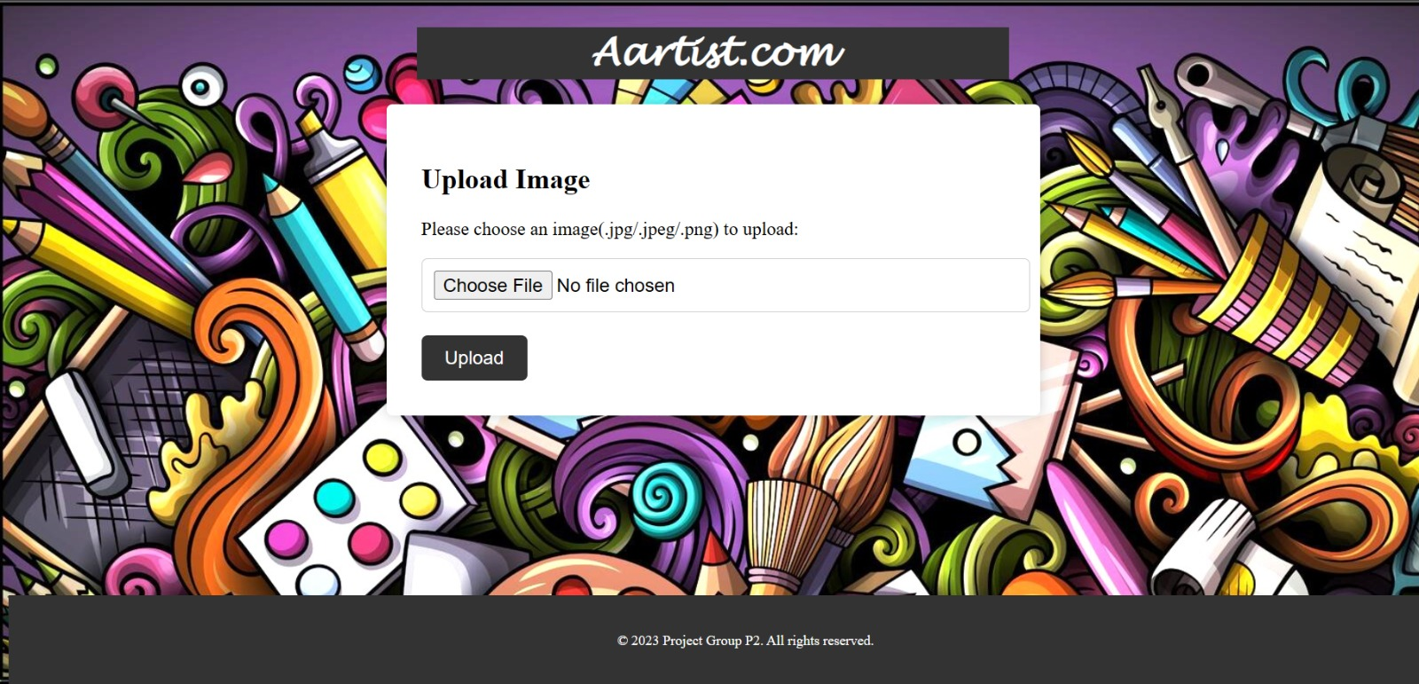
Web Page

Slide 13
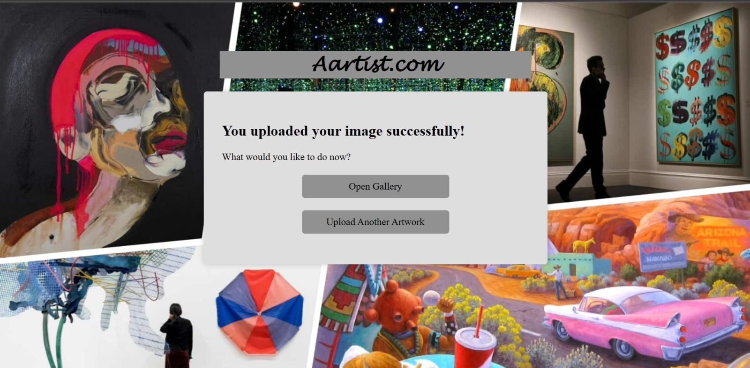
Web Page

Slide 14

Web Page

Slide 15

Web Page

Slide 16

Thank You
Github Link - https://github.com/CSD-project/webpage

Slide 17

Appendix

Slide 18
Sprint Planning
Main role play product owner and scrum master
Planning done by product owner and work assign to team by scrum master.
Daily Stand-up
Daily meeting arrange by scrum master 15 min for taking updates.
Sprint Review
Meeting lead by scrum master and taking review from deployment team.
Sprint Retrospective
Meeting lead by both scrum master and product owner reviewing what is being implemented in sprint and is there room for improvement.
Product Backlog Grooming
Ceremonies Of Scrum Master

Slide 19
Sprint Planning
Main role play product owner and scrum master
Planning for each sprint and sprint estimation is done
Creating backlog.
Main role is played by the product owner
The user story, story point estimation takes place
Product Grooming
Main role is played by product owner with other members of the team, before each sprint starts
Reviewing Sprint
This is done together with scrum so as to see till where has the project requirements are met
Serving as Primary contact
Product owner works as the main contact between the client and the team members
Ceremonies Of Product Owner

Slide 20

Product Backlog Grooming
This is meeting held during sprint about coming backlog.
Main people –scrum master and Product Owner
Lead by- Product Owner
Points that will discuss:
What is coming in next sprint.
Discussion with development team.
Breaking down broad user stories into smaller items.
Identifying roadblocks and minimizing risks related to backlog items.

Slide 21
Ceremonies of Delivery Team
Teamwork, complete the task assigned by scrum master within deadline.
Provide daily update to scrum master in daily standup(done, going do, Impediment)
Backend Team
AWS S3 service
AWS Lambda Service

Slide 22

Best Code Practices
Variable, Class and Function Naming convention
Clear and Concise comments
Code Indentation
Reusability and Scalability
DRY Principle

Slide 23




USER
The user address their issue
The customer care responds to the queries
CUSTOMER CARE
Gives feedbacks on the common issues faced by the users
SUPPORT TEAM
Gives feedback on the issues that are to be resolved by a development team
CLIENT COMPANY

